Slide 1
Students participating in rally of importance of cleanliness.

Slide 2
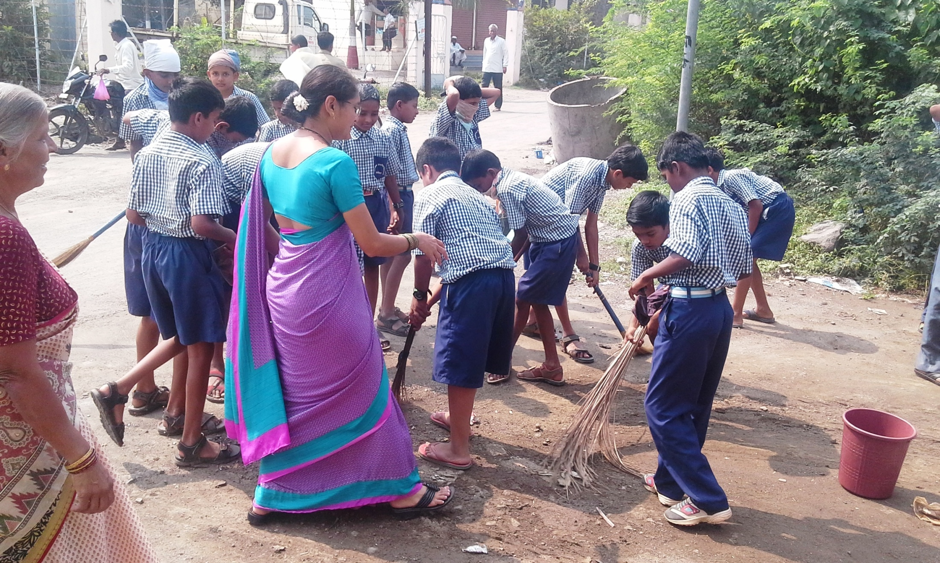
Children cleaning the surrounding area with their teachers.

Slide 3
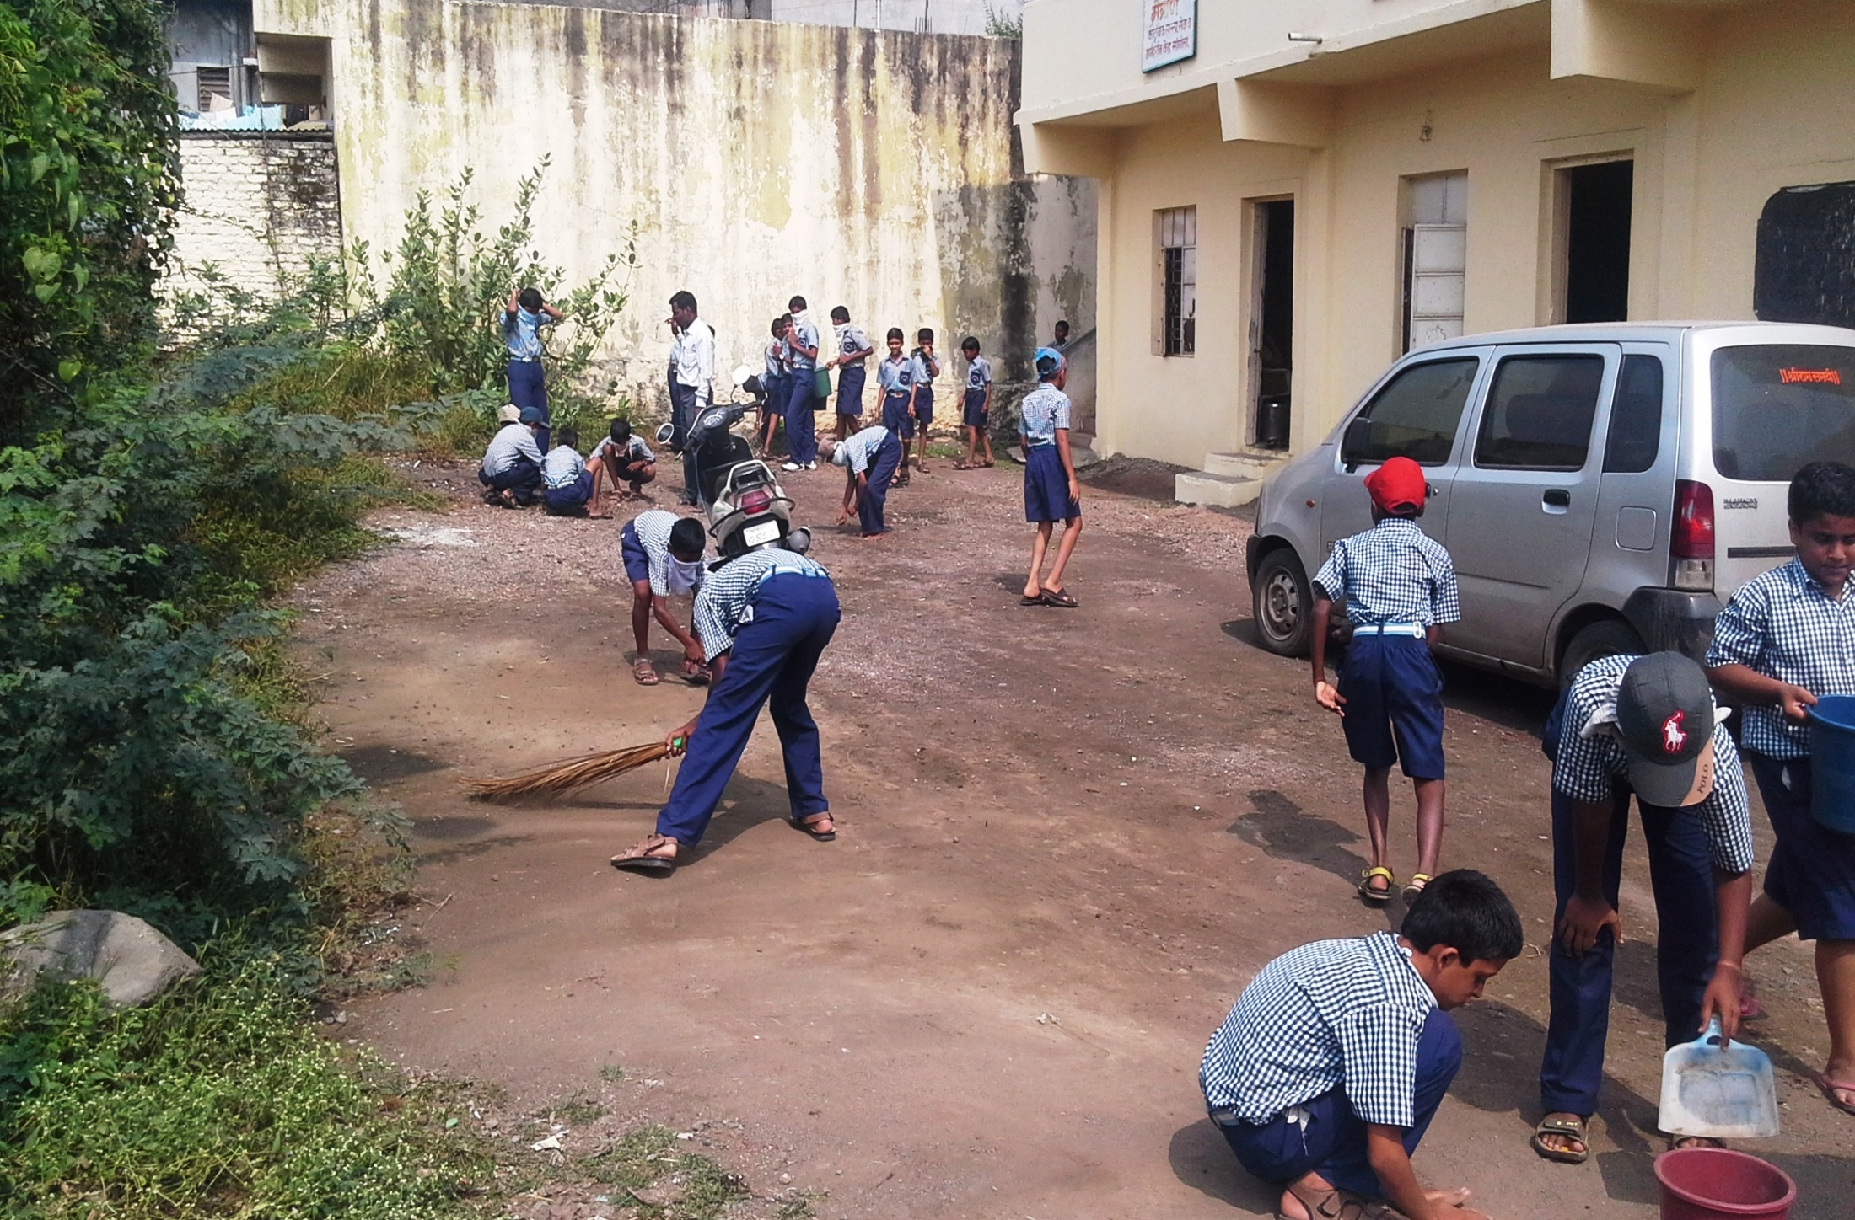
Children cleaning the area.

Slide 4
Students counseling about the importance of cleanliness to the people in their area.

Slide 5
On the occasion of Marathi day the visit of child artists of Award wining Marathi movie “ Elizabeth ekadashi ”

Slide 6
Children celebrating the Marathi day

Slide 7
Children learning in Science exhibition on occasion Science day.

Slide 8
Students showing image effects to their teachers in Science Exhibition on Science day.

Slide 9
Children of 1st Std celebrating Science day with their teachers.

Slide 10
Students giving present of a picture to story writer Mr. Vishwas kachare which is related to their lesson of Marathi in 6th Std

Slide 11
Students playing Kho-Kho in annual Sports Meet.

Slide 12
Girls playing Kabbaddi in Annual Sports Meet

Slide 14
Students putting on Rangoli designs in Rangoli designing competition.

Slide 18
Students enjoying Funny games.

Slide 19
Teachers and students enjoying in the funny games.

Slide 20
Children enjoying their colored pictures in coloring competitions in summer camp.

Slide 21
Students doing Exercise (Suryanamaskar) in summer camp.

Slide 22
Thank you Sir…

